Slide 1
CHAPTER 14
Visual Persuasion
Prepared by Robert Gass and John Seiter

Slide 2
iMAGE IS EVERYTHING
In Communication Studies, visual persuasion is often overlooked, neglected
Persuasion’s traditional focus has been on oral and/or textual messages
emphasis is on persuasion within the “world of words”
the role of images in general, and art in particular, has been neglected
But images are highly persuasive
Picture superiority effect: pictures are more readily recognized and remembered than words

Slide 3
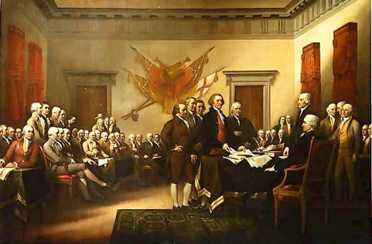
HOW IMAGES PERSUADE
Iconicity
An image stands for the thing it represents
Uncle Sam is an icon for America
Indexicality
Images can document events.
Marines raising the flag on Iwo Jima
Syntactic Indeterminacy
Images lack syntax and logical operators.
Advertisers associate brands with idealized lifestyles
This painting by John Trumbull supposedly “documents” the signing of the Declaration of Independence. However, no such ceremony actually took place.
Image courtesy of www.teachersparadise.com

Slide 4
ART AS PERSUASION
Art serves more than an aesthetic or decorative function
Artists persuade in and through their art
Art provides social critiques
Art can spark controversy
Art increases awareness
The cover of the New Yorker magazine depicted Barack and Michelle Obama as fist-bumping, flag-burning, Muslim extremists
Danish cartoon caricatures of the prophet Muhammad provoked violent protests
Graffiti artist, Banksy, has stenciled anti-established images in public places
Notes:
A link to the July 21, 2008 New Yorker cover can be found at
http://archives.newyorker.com/?i=2008-07-21
or
http://www.huffingtonpost.com/2008/07/13/yikes-controversial-emnew_n_112429.html
Banksy’s images can be seen at the link below
http://www.banksy.co.uk/indoors/napalm.html

Slide 5
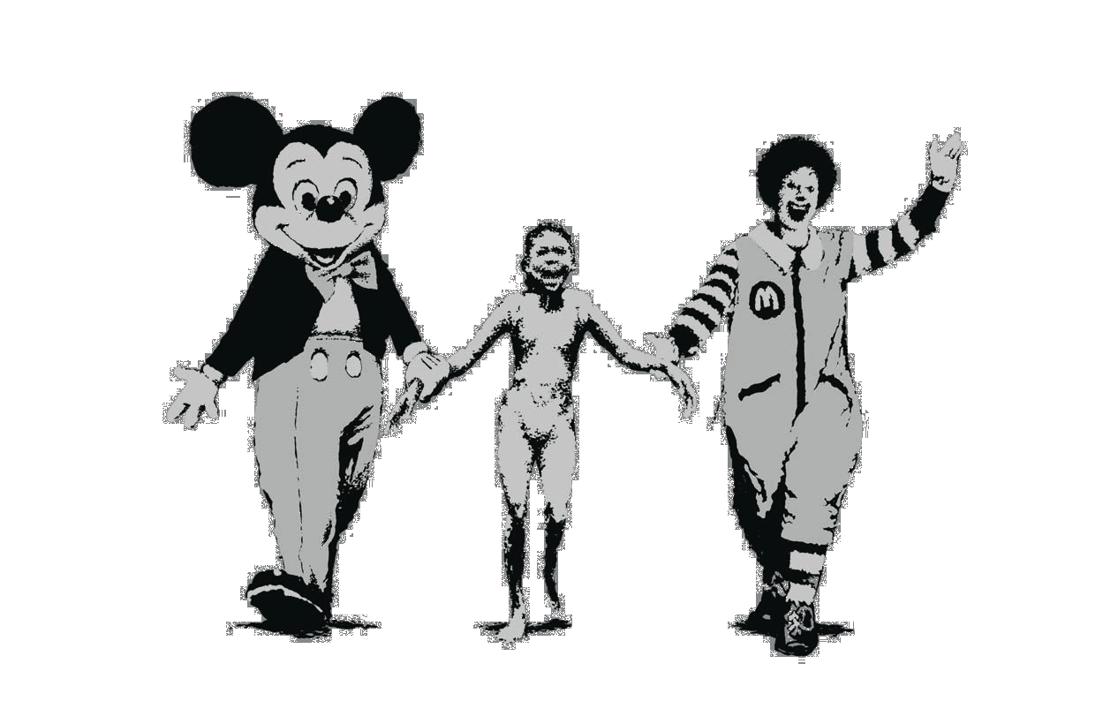
Controversial art
Banksy, a “guerilla artist” stencils controversial images in public places
“Napalm” depicts corporate icons alongside a napalm victim
The image draws on Nick Ute’s Pulitzer prize winning photo
The image critiques exploitation by multinational corporations
Image courtesy of Banksy
http://www.banksy.co.uk/indoors/napalm.html
Notes:
For a discussion of Banksy’s “Napalm” see
http://www.metapedia.com/wiki/index.php?title=Jlb244
http://vclogbook.blogspot.com/2008/02/semiotics-analysis-last-assignment.html

Slide 6
Pro-government & Anti-government art
The USSR used art to promote the ends of the state
Chinese poster art deified Chairman Mao
During the “New Deal” era, the U.S. government sponsored pubic arts projects
European artists aimed their art against the government
Picassos’ Guernica” Eugene Delacroix’s “Liberty Leading the People” (1830)
Diego Rivera’s murals
Notes:
Government archives of New Deal art are available at
http://www.archives.gov/exhibits/new_deal_for_the_arts/index.html

Slide 7
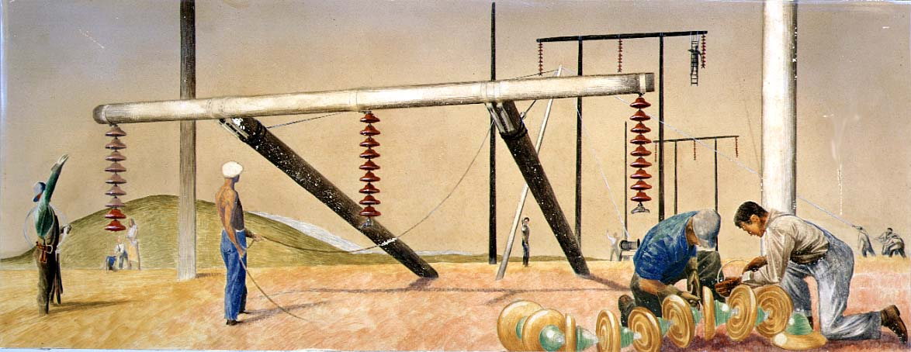
Pro-government art
This painting depicts the “New Deal” bringing electricity to rural America. At the time nine out of ten farms had no electricity (David Stone, Electrification, 1940)
Notes:
This is a government image in the National Archives, and is therefore in the public domain and available under the fair use doctrine.
Government archives of New Deal art are available at
http://www.archives.gov/exhibits/new_deal_for_the_arts/index.html

Slide 8
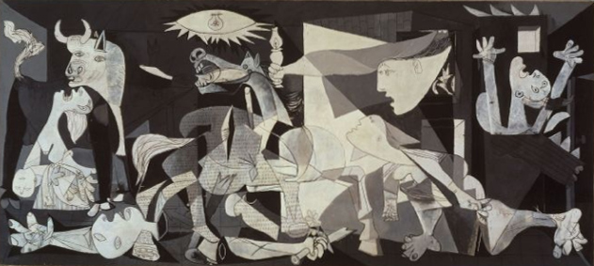
Anti-government Art
Picasso’s Guernica (1937) depicted the indiscriminant bombing of a Basque town during the Spanish civil war. The work symbolizes the horror of war and was directed at Franco’s Nationalist forces
Notes:
This image is from Wikipedia and is in the public domain.
http://en.wikipedia.org/wiki/Guernica_(painting)

Slide 9
How Art Persuades
Art shines a spotlight on society
Awareness through interpretation
Suzanne Lacy, “Three Weeks in May”
Awareness through participation
Wafa Bilal’s “Shoot an Iraqi” project
The Names Project

Slide 10
Cinematic Persuasion
Movies are a form of persuasion
They are carefully crafted works
They reach large audiences
Potential for mass influence
Movies are told in a narrative form
People gravitate toward stories
Stories possess an aura of believability

Slide 11
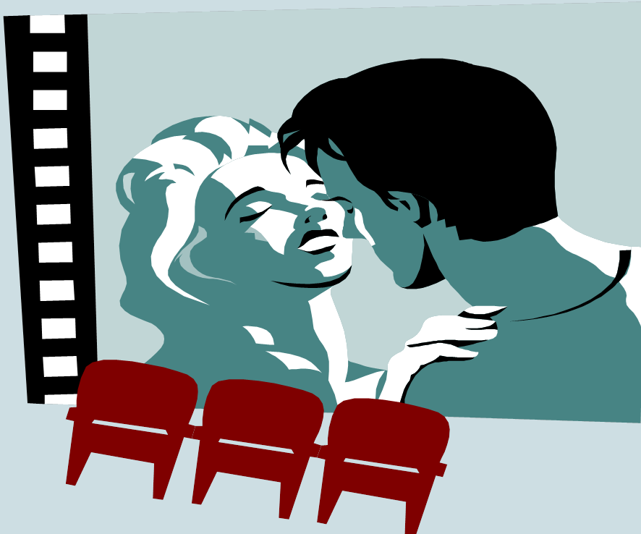
Cinematic Influence
People may not expect to be persuaded during a movie
Viewers engage in a “willing suspension of disbelief.”
Films may persuade intentionally.
Michael Moore’s films
Inconvenient Truth
Brokeback Mountain
Films may persuade unintentionally
Juno
Superbad

Slide 12
Exporting cultural values
American movies export cultural values around the world
Western movies promote positive values
democracy
equality
freedom
justice
Western movies promote negative values
materialism
promiscuity
violence

Slide 13
Promoting popular culture
Fashion
Leg warmers
Platform shoes
Stirrup pants
Hairstyles
Jennifer Aniston
Farah Fawcett
Dance
Disco
Breakdancing
Hip-Hop
Lifestyles
Counter-culture
Goth culture
Hip Hop Culture
Slang and expressions
“Show me the money.”
“Talk to the hand.”
“You had me at hello.”
“Life is a box of chocolates.”

Slide 14
Cinematic Social Proof
Movie characters model risky behaviors
Smoking
Smoking rates in cinema are disproportionately higher than for the public at large (Omidvari, et al., 2005)
Alcohol abuse
Movies frequently depict underage drinking and driving
Unsafe sex
98% of movies with sex scenes make no mention of safe sex (Gunasekera & Chapman, 2005)
Violence
Gratuitous violence is commonplace on the Big Screen
Notes:
“risk-glorifying media has potentially grave consequences, such as innumerable incidences of fatalities, injuries and high economic costs in a broad variety of risk-taking domains, such as substance abuse, reckless driving, gambling and risky sexual behavior” (Fisher, 2011)
Shows such as Mad Men glamorize smoking.
Over the past six years more than half of the movies geared toward children feature characters smoking (AMA, 2008).
Teenagers are significantly more likely to smoke if they watch movies featuring stars who smoke (Dalton, 2003)
89% of smoking is initiated during adolescence (Johnston, O’Malley, & Bachman, 1996)
http://www.screenit.com/search_movies.html
seat belt usage in movies is quite low, typically between 10-30% (Jacobsen, Kreuter, Luke, & Caburnay The national average is closer to 70%.
Movies with cannabis (8%) and other non-injected illicit drugs (7%) were less common than those with alcohol intoxication (32%) and tobacco use (68%)

Slide 15
Cinematic Social Proof
Positive social modeling
Finding Nemo normalized disabilities
Guess Who’s Coming to Dinner tackled the subject of racial integration.
Milk chronicled the gay rights movement.
Tomb Raider, the Terminator films, Resident Evil, and other films portray smart, tough, empowered female protagonists.

Slide 16
CULTIVATION THEORY
heavy exposure to movies cultivates attitudes more consistent with the media version of reality than with reality itself
“Heavy” viewers have a more distorted view of the world than “Light” viewers
Heavy viewers develop a view of a “mean, scary world”
Movies and TV provide biased, stereotyped depictions of reality, which can distort the beliefs of heavy viewers

Slide 17
Promoting viewer identification
Stories in film overlap with viewers’ experience
Viewers may identify closely with a character
Rocky, Rudy, Slumdog Millionaire championed the underdog.
Napoleon Dynamite, Pretty in Pink, Superbad championed social outcasts.

Slide 18
Perpetuating stereotypes
Movies equate beautiful/handsome with good, ugly with bad
African/Black
Often depicted as drug dealers, pimps, felons
Asians
Often depicted as undersexed, romantically awkward, good at martial arts
Hispanics
Often depicted as gang members, maids
Middle-Easterners
Often depicted as terrorists, taxi drivers,
Females
Often depicted as thin, beautiful, airheaded
Few leading roles for older actresses
Few leading roles for heavy actresses.

Slide 19
Positive stereotypes TOO
Many recent films have embraced diversity, promoted intercultural awareness, and fostered interracial tolerance
Kite Runner
Joy Luck Club
Slumdog Millionaire
Gran Torino
My Big Fat Greek Wedding

Slide 20
Images in advertising
Images are the bread and butter of advertising campaigns
Consumers viewed 4.6 billion ads in 2012*
In 2013, $518 billion will be spent on advertising worldwide**
Almost $300 billion per year is spent on advertising in the U.S.A.
The average person is exposed to 300-3,000 ads per day
The average person sees 1,700 banner ads per month***
Notes:
*http://adage.com/article/digitalnext/ten-stats-change-video-2013/238915/#Scene_1
**http://www.allaccess.com/net-news/archive/story/117868/study-global-ad-expenditure-to-grow-3-9-in-2013
***http://blog.hubspot.com/horrifying-display-advertising-stats

Slide 21
ANTI-ADS
Anti-ads parody traditional advertising
Smoking prevention ads satirize the glamorization of cigarettes
GoDaddy’s ads simultaneously mock and emulate sex appeals
Anti-ads appeal to skeptical consumers who distrust advertising
Anti-ads appear to respect the viewer’s intelligence

Slide 22
Product placement
Product placement
Apple has placed its products in more than 1,500 TV shows.
James Bond movies always feature a cool car.
Windex was the cure for everything in My Big Fat Greek Wedding.
Brandchannel.com lists product placements in movies.

Slide 23
Image oriented advertising
Luxury brands
Mercedes, Ralph Lauren, Prada
Aspirational brands
Rolls Royce, Tesla, Vera Wang
Genuine, authentic brands
Artisanal cheeses, organic foods, handmade goods
Common associations in advertising
Social status and elitism
Sex and romance
Cause-related
Power, speed, strength
Youth culture
Cool, hip, trendy
Safety security
Sense of place, belonging

Slide 24
Shock advertising
Media clutter: consumers are bombarded with 3,000 messages per day
Shock ads seek to stand out against the background of media clutter
Shock ads attempt to exploit a norm violation
The goal is to be disturbing, offensive, crass, tasteless, edgy
capture attention by braking through media clutter
increase awareness, recognition
generate media buzz through social controversy
promote memory, retention of an issue

Slide 25
Shock advertising
Example: GoDaddy.com’s 2013 Superbowl commercial, “Sexy meets smart”
Shock ads increase attention and retention (Dahl,
Frankenberger, & Manchanda (2003)
Shock ads walk a thin line between not being shocking enough and being offensive

Slide 26
Photographic Persuasion
The myth of photographic objectivity
Photographs are not objective representations of reality.
Photography is a subjective medium.
Photographers manipulate
the subject matter
framing
perspective
lighting
composition
film (color, black & white)
camera angle
focus
contrast
which images to print
cropping
shutter speed

Slide 27
The camera always lies
Famous faked photos
The Cottingly Fairies
Loch Ness monster
John Kerry sharing the podium with Jane Fonda
Brian Walski’s doctored Iraq photo
Adnan Hajj’s photo of thick black some over Beirut, Lebanon
Tourist atop Twin Towers as plane approaches
Newsweek alteration of O.J. Simpson’s skin tone
In the digital age images can be manipulated more easily
Heads can be cropped and replaced.
Lighting angles can be altered.
New software is becoming available for identifying digital fakery
Notes:
Examples of these images can bee seen at
http://news.cnet.com/2300-1026_3-6033210-1.html
http://ome7.blogspot.com/2009/05/10-famous-fake-photos.html

